Slide 1


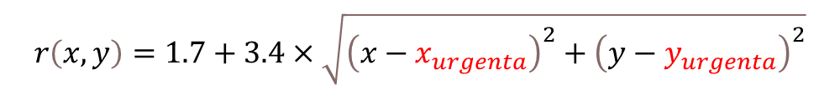

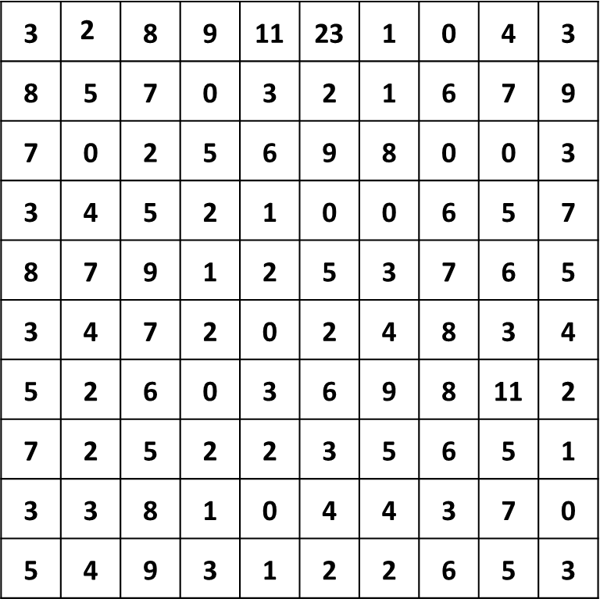




n
n
3 | $$\text{2}$$ | 8 | 9 | 11 | 23 | 1 | 0 | 4 | 3
8 | 5 | 7 | 0 | 3 | 2 | 1 | 6 | 7 | 9
7 | 0 | 2 | 5 | 6 | 9 | 8 | 0 | 0 | 3
3 | 4 | 5 | 2 | 1 | 0 | 0 | 6 | 5 | 7
8 | 7 | 9 | 1 | 2 | 5 | 3 | 7 | 6 | 5
3 | 4 | 7 | 2 | 0 | 2 | 4 | 8 | 3 | 4
5 | 2 | 6 | 0 | 3 | 6 | 9 | 8 | 11 | 2
7 | 2 | 5 | 2 | 2 | 3 | 5 | 6 | 5 | 1
3 | 3 | 8 | 1 | 0 | 4 | 4 | 3 | 7 | 0
5 | 4 | 9 | 3 | 1 | 2 | 2 | 6 | 5 | 3
Response time for a sector:
$$r\left(x,y\right)=1.7+3.4×\sqrt{{\left(x−x_{urgenta}\right)}^{2}+{\left(y−y_{urgenta}\right)}^{2}}$$
$$y_{urg.}$$
Total response time
$$cost\left(x,y\right)=\sum_{x=1}^{n}{\sum_{y=1}^{n}{w_{\left(x,y\right)}∙r\left(x,y\right)}}$$
$x_{urgenta}$ = ?
$cost\left(x,y\right)$ minim ⇨
$$x_{urg.}$$
$y_{urgenta}$ = ?
City

Slide 2
Representation
Each sector: pair of coordinates (integers), response time (real) ⇨ list 2+1 elements
Population
List of lists ( dim * (2+1) )
Stop condition
Number of generations, genetic diversity, fitness improvements in the last nmax/3 generations
Selection of parents
Size 2 tournament ⇨ 2 pairs of parents
Crossover
Single-point (between the 2 genes), probability 1 ⇨ 4 descendants
Mutation
Random reset, probability ¼ (4 descendants = 8 genes)
Next generation selection: stable state model
(GENITOR) 4 descendants replace the 4 weakest individuals

Slide 3
Homework
Rewrite the implementation using
a matrix to represent the population: dim * 2
A separate vector to store the fitness of each individual
Rewrite the GENITOR selection function, without sorting the population

